Slide 1
Network Layer Routing Algorithm Link State Routing
Lecture 14 | Part 1| CSE421 – Computer Networks
Department of Computer Science and Engineering School of Data & Science

Slide 2
Chapter 4: Network Layer
4.5 Routing algorithms
Distance Vector
Link state
Hierarchical routing
4.6 Routing in the Internet
RIP
OSPF
BGP
4. 1 Introduction
4.2 Virtual circuit and datagram networks
4.3 What’s inside a router
4.4 IP: Internet Protocol
Datagram format
IPv4 addressing
ICMP
IPv6
Notes:
‹#›

Slide 3
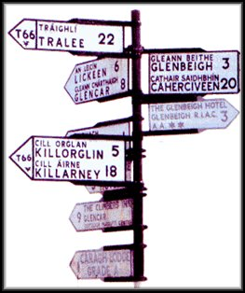
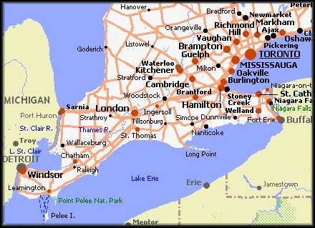
Link-State Routing Protocols
Distance Vector routing protocols are like road signs.
Routers must make preferred path decisions based on a distance or metric to a network.
Link-State routing protocols are more like a road map.
They create a topological map of the network and each router uses this map to determine the shortest path to each network.

Slide 4

Link-State Routing Protocols
Centralized Routing Algorithm
computes the least-cost path using complete, global knowledge about the network.
Link-state routing protocols are also known as shortest path first protocols
The Link state routing protocol uses Dijkstra's algorithm which is used to find the shortest path from one node to every other node in the network.
While they have the reputation of being much more complex than distance vector, the basic functionality and configuration of link state routing protocols are not complex.

Slide 5
A Link-State Routing Algorithm
Dijkstra’s algorithm- Shortest Path First
net topology, link costs known to all nodes
accomplished via “link state broadcast”
all nodes have same info
computes least cost paths from one node (“source”) to all other nodes
gives forwarding table for that node
iterative: after k iterations, know least cost path to k destinations
Notes:
‹#›

Slide 6

Dijkstra’s algorithm
Notation:
c(x,y): link cost from node x to y; = ∞ if not direct neighbors
D(v): current value of cost of path from source to dest. v
p(v): predecessor node along path from source to v
N': set of nodes whose least cost path definitively known
5
v
3
w
2
5
u
2
1
z
3
1
2
x
y
1

Slide 7
Dijsktra’s Algorithm
1 Initialization:
2 N' = {u}
3 for all nodes v
4 if v adjacent to u
5 then D(v) = c(u,v)
6 else D(v) = ∞
7
8 Loop
9 find w not in N' such that D(w) is a minimum
10 add w to N'
11 update D(v) for all v adjacent to w and not in N' :
12 D(v) = min( D(v), D(w) + c(w,v) )
13 /* new cost to v is either old cost to v or known
14 shortest path cost to w plus cost from w to v */
15 until all nodes in N'
Notes:
‹#›

Slide 8
Dijkstra’s algorithm: example
Step
0
1
2
3
4
5
N'
u
ux
uxy
uxyv
uxyvw
uxyvwz
D(v),p(v)
2,u
2,u
2,u
D(w),p(w)
5,u
4,x
3,y
3,y
D(x),p(x)
1,u
D(y),p(y)
∞
2,x
D(z),p(z)
∞
∞
4,y
4,y
4,y
5
v
3
w
2
5
u
2
1
z
3
1
2
x
y
1
Notes:
‹#›

Slide 9
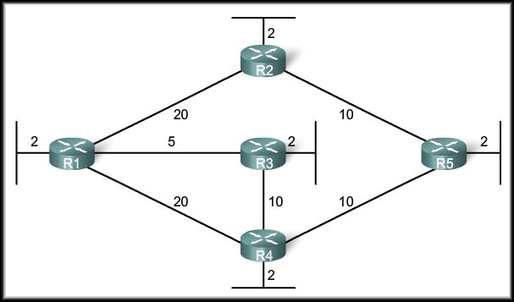
SPF Algorithm - Example
Dijkstra’s algorithm is commonly referred to as the Shortest Path First (SPF) algorithm.
This algorithm accumulates costs along each path, from source to destination.

Slide 10
SPF Algorithm
To illustrate how SPF operates, each path in the figure is labeled with an arbitrary value for cost.
Each router calculates the SPF algorithm and determines the cost of a link from its own perspective.

Slide 11
SPF Algorithm
For example:
The cost of the shortest path for R2 to send packets to the LAN attached to R3 is 27 (20 + 5 + 2 = 27).

Slide 12
SPF Algorithm
R1 uses 3 “hops” but “faster” links.
27
32
R1 has data to send to the network on R5.
You might think that R1 would send directly to R4 (2 hops) instead of to R3 (3 hops).

Slide 13
Network Layer Routing Algorithm Link State Routing
Lecture 14 | Part 2| CSE421 – Computer Networks
Department of Computer Science and Engineering School of Data & Science

Slide 14
Link-State Routing Process
5 Step Process
Each router learns about its own directly connected networks.
Each router is responsible for contacting its neighbors (exchange Hello packet) on directly connected networks.
Each router builds a link-state packet (LSP) containing the state of each directly connected link.
Each router floods the LSP to all routers, who then store all LSPs received in a database.
Each router uses the LSPs to construct a database that is a complete map of the topology and computes the best path to each destination network.
Notes:
How does a link-state routing protocol work?
How does a link-state routing protocol work?

Slide 15
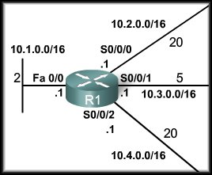
Step 1: Directly Connected Networks
We will focus on the Link-State routing process from the perspective of R1.
Each router learns about its own directly connected networks.
When a router interface is configured with an IP address and subnet mask and activated, the interface becomes part of that network.
Regardless of the routing protocols used, these directly connected networks are now part of the routing table.

Slide 16
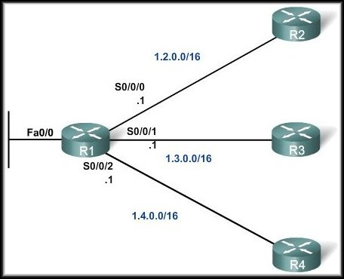
Step 2: Hello Packets
Each router is responsible for contacting its neighbors on directly connected networks.
The router will not be aware of any neighbor routers on the link until it receives a Hello packet from that neighbor.
At that time, it establishes an adjacency with the neighboring router.

Slide 17
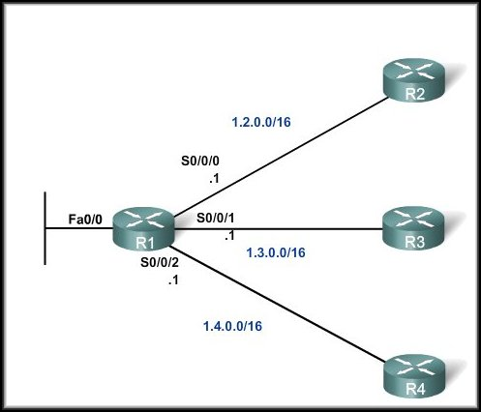
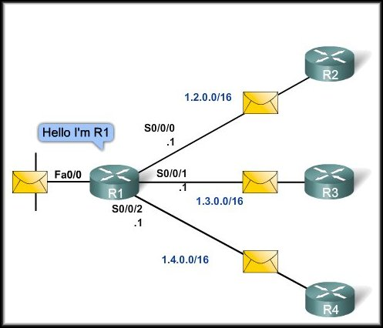
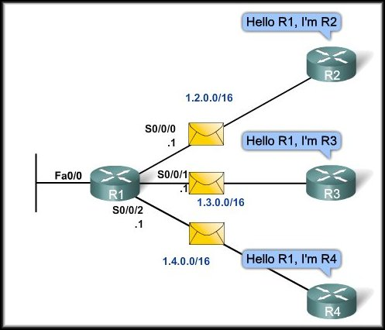
Step 2: Hello Packets

Slide 18
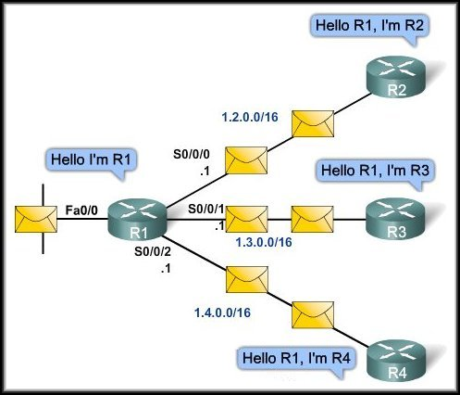
Step 2: Hello Packets
A neighbor is any other router that is enabled with the same link-state routing protocol.
These small Hello packets continue to be exchanged between two adjacent neighbors.
These packets serve as a keep alive function to monitor the state of the neighbor.

Slide 19
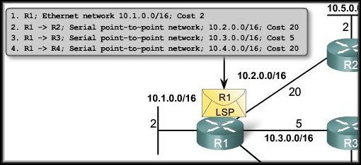
Step 3: Build the Link-State Packet
Each router builds a link-state packet (LSP) containing the state of each directly connected link.
The LSP contains the link-state information about the sending router’s links.
The router only sends LSPs out interfaces where it has established adjacencies with other routers.

Slide 20
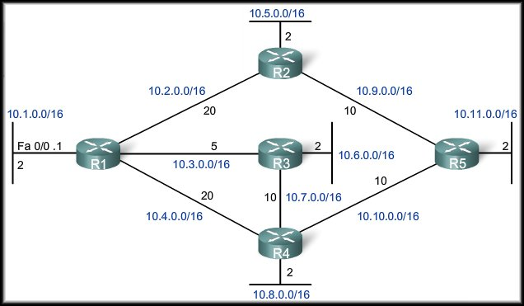
Step 4: Flooding Link-State Packets
No response to Hello – no LSP sent.
Flooding of R1 LSP
Each router floods the LSP to all neighbors, who then store all LSPs received in a database.
Whenever a router receives an LSP from a neighboring router, it immediately sends that LSP out all other interfaces, except the interface that received the LSP.

Slide 21
Step 4: Flooding Link-State Packets
Link-state routing protocols calculate the SPF algorithm after the flooding is complete.
As a result, link-state routing protocols reach convergence much faster than distance vector routing protocols.

Slide 22
Step 4: Flooding Link-State Packets
An LSP needs to be sent only:
During initial startup of the router or routing protocol.
Whenever there is a change in the topology (link going down or coming up) or a neighbor adjacency being established or broken.

Slide 23
Step 5: Constructing a Link-State Database
Each router uses the LSPs to construct a database that is a complete map of the topology and computes the best path to each destination network.

Slide 24
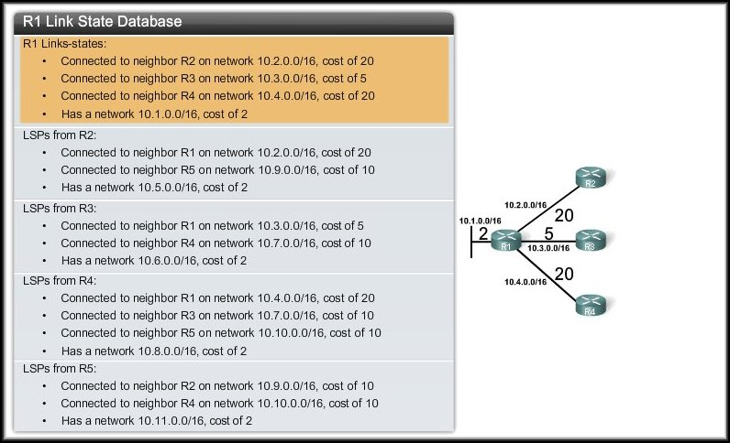
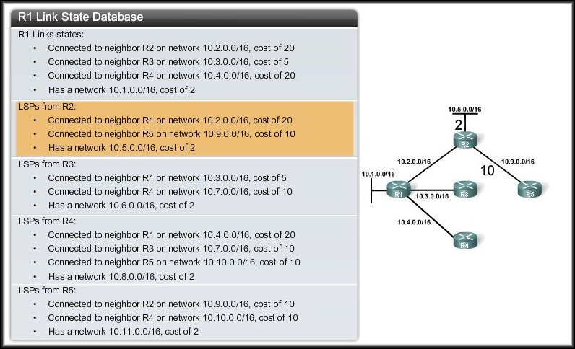
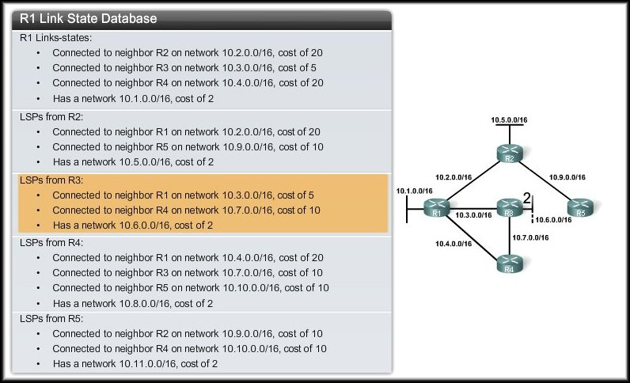
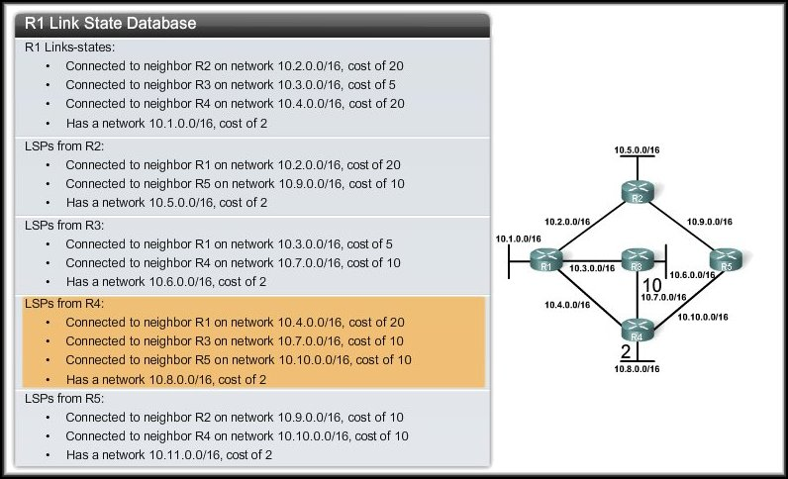
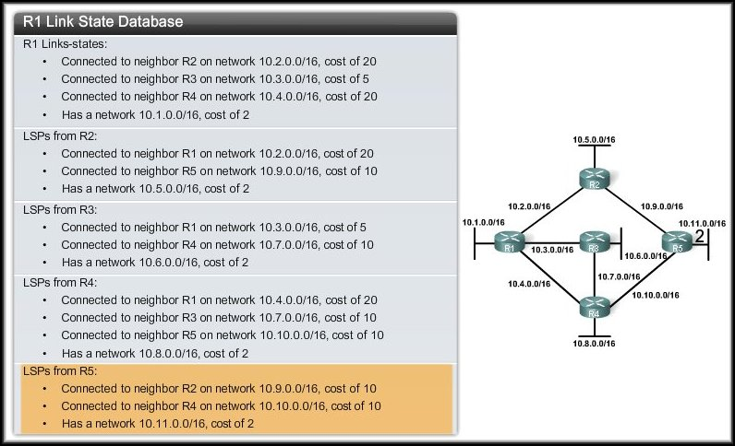
R1: Building the SPF Tree

Slide 25
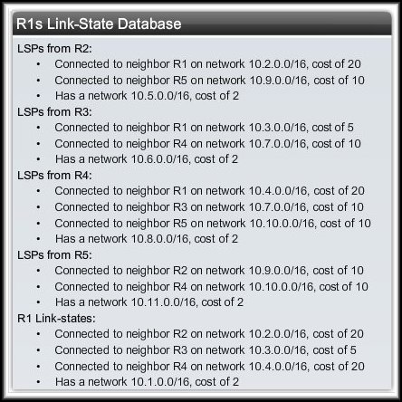
Step 5: Constructing a Link-State Database
As a result of the flooding process, router R1 has learned the link-state information for each router in its routing area.

Slide 26
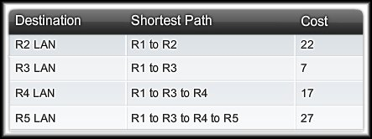
Step 5: Constructing a Link-State Database
Each router in the topology determines the shortest path from its own perspective.
With a complete link-state database, R1 can now use the database and the shortest path first (SPF) algorithm to calculate the preferred path or shortest path to each network.

Slide 27
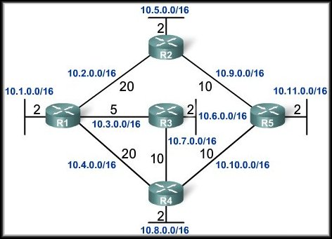
R1: Building the SPF Tree
Root
All LSPs have been processed using the SPF algorithm and R1 has now constructed the complete SPF tree.

Slide 28
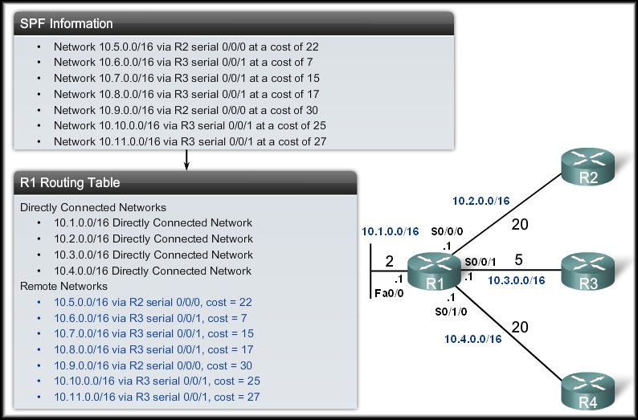
Generating a Routing Table

Slide 29
Building Routing Table
Creation of the states of the links by each node, called the link state packets (LSP)
Dissemination of LSPs to every other routers, called flooding (efficiently)
Constructing a Link-State Database using LSPs
Formation of a shortest path tree for each node
Calculation of a routing table based on the shortest path tree

Slide 30
Advantages: Link-State Routing
Fast Network Convergence– On receiving an LSP, link-state routing protocols immediately flood the LSP out all interfaces without any changes except for the interface from which the LSP was received.
Topological Map– Using the SPF tree, each router can separately determine the shortest path to every network.
Hierarchical Design– Link-state routing protocols use multiple areas and create a hierarchical design to networks areas. The multiple areas allow better route summarization.
Event-driven Updates– After initial flooding of LSPs, the LSPs are sent only when there is a change in the topology and contain only the information regarding that change. The LSP contains only the information about the affected link. The link-state never sends periodic updates.

Slide 31
Comparison
 | Distance Vector | Link State
Network view | Topology knowledge from the neighbor point of view | Common and complete knowledge of the network topology
Best Path Calculation | Based on fewest number of hops | Based on the link cost
Updates | Full routing table | Link State Updates
Algorithm | Bellman-Ford | Dijsktra
CPU and Memory | Low utilization | Intensive
hierarchical Structure | No | Yes
Convergence time | Moderate | Fast

Slide 32
THE END

